Slide 1
Electronics 101 with Raspberry Pi – Rotation 1
David Crook
@Data4Bots
Questions: dacrook@Microsoft.com

Slide 2
Agenda
The ‘me’ slide
Things to know
Goals
Content
Summary
Continuous Q&A

Slide 3
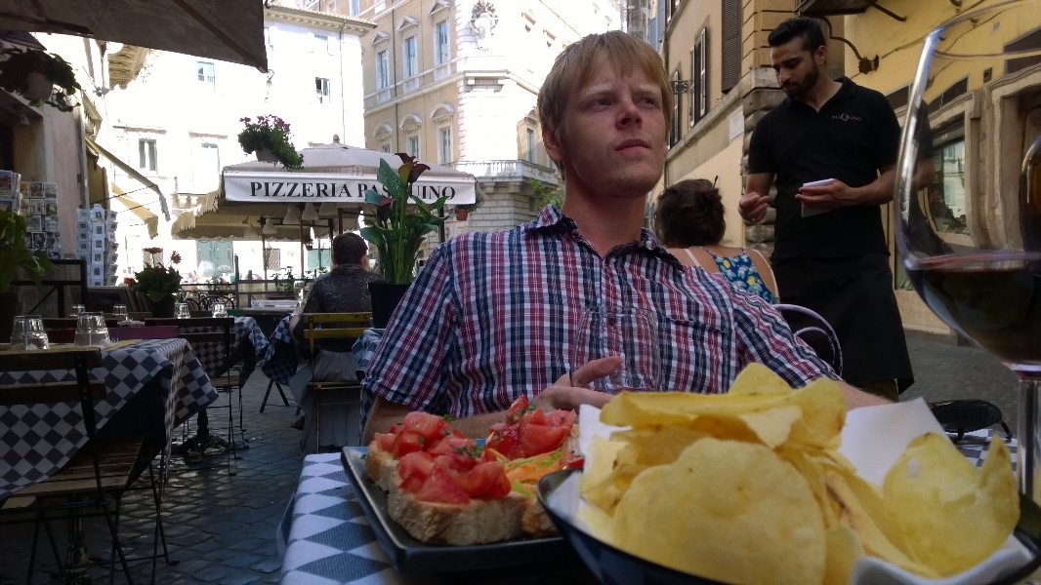
David Crook
Microsoft Developer Evangelist
Focused on Machine Learning and Embedded Systems
Enjoys challenges
Likes Fishing + Brazilian Jiu Jitsu
Typically not together
dacrook@Microsoft.com
(980)228-6278
@Data4Bots
www.indiedevspot.com

Slide 4
Stuff you should Know About
Additional Resources
Channel9: http://channel9.msdn.com
Hackster: https://www.hackster.io
Stack Overflow: http://electronics.stackexchange.com/
BizSpark
Free Azure
Free Tools Network Partner Give to your startups for free
Microsoft Innovation Center
Hack Tuesdays: Mentoring every Tuesday 11am – 4pm
Free Co-Working for Startups: dacrook@Microsoft.com to apply
Free Training: See schedule here: http://indiedevspot.com/events/

Slide 5
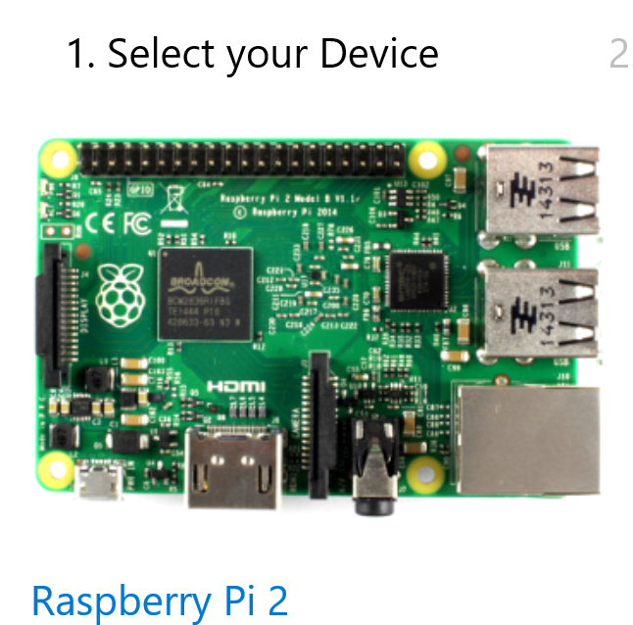
Future Reference Getting Started
http://ms-iot.github.io/content/en-US/GetStarted.htm

Slide 6
Goals of Presentation
Understand Raspberry Pi Pin breakout
Ability to read circuit schematics
Ability to read data sheets
Understand Breadboards
Understanding Windows 10 IoT Core
Complete Blinky LED and Toy Motor

Slide 7
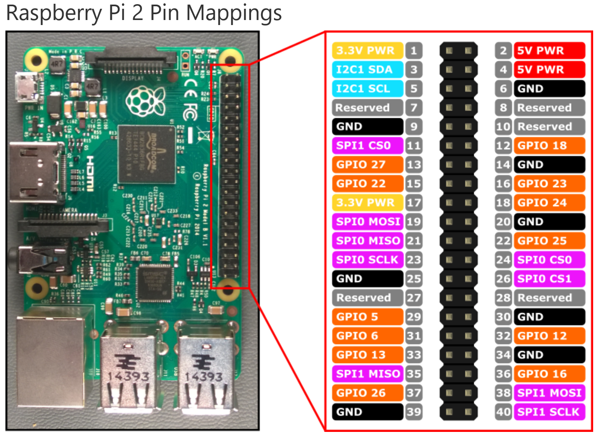
Will not concern
ourselves with:
I2C
SPI
Focus just on
Power
Ground
Gpio
Physical Pin
vs
Logical Pin

Slide 8
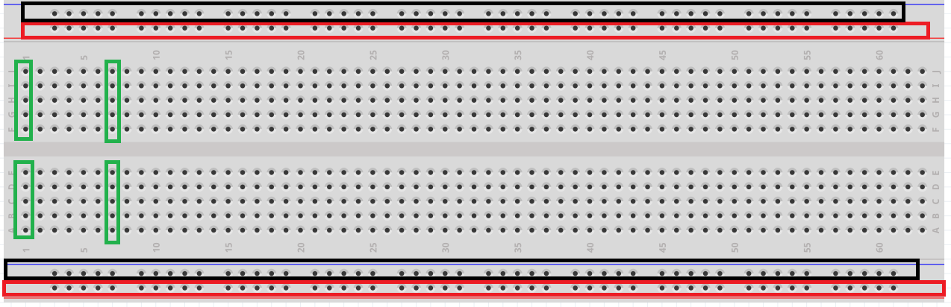
How a Breadboard works

Slide 9
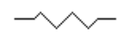
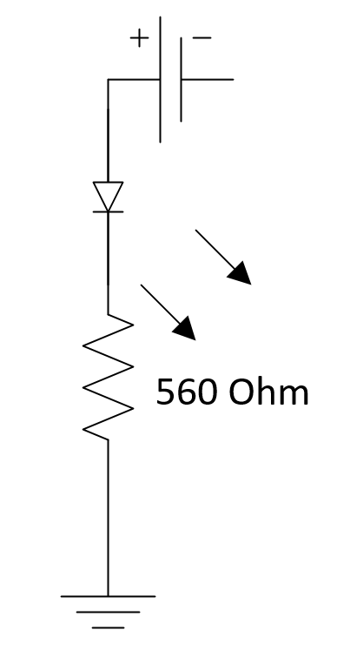
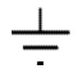
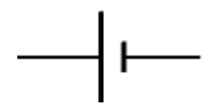
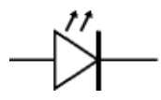
Circuit Schematics – Symbols – LED Sample
Resistor
Ground
Power
LED

Slide 10
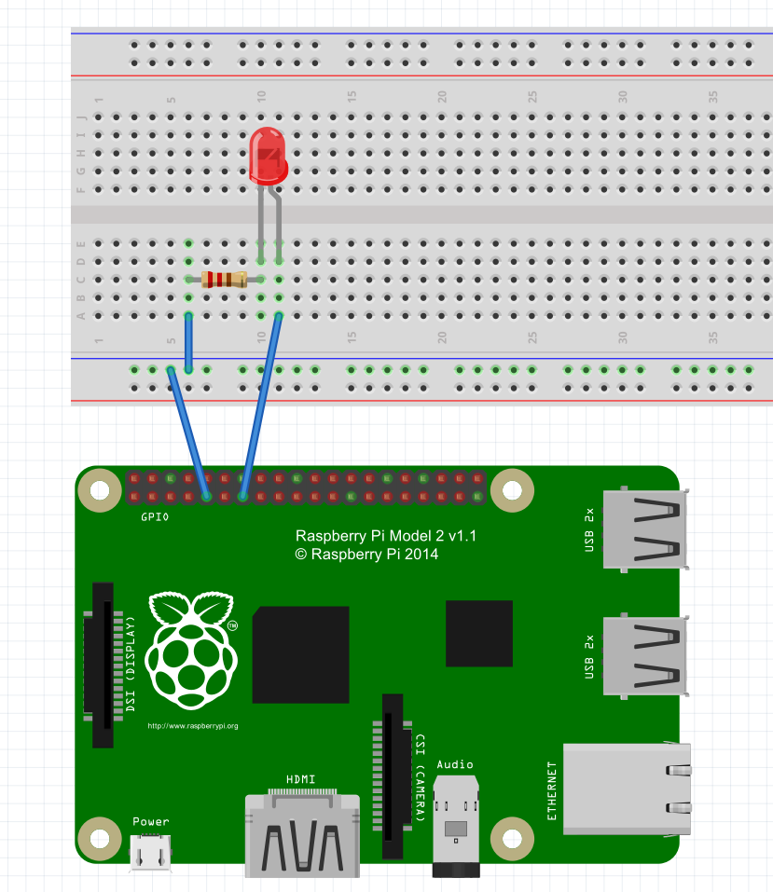
Wiring Diagram

Slide 11
Blinking the light
Open Visual Studio 2015 Community
Excellent programming tool.
Create new Project and Solution
File -> New -> Project

Slide 12
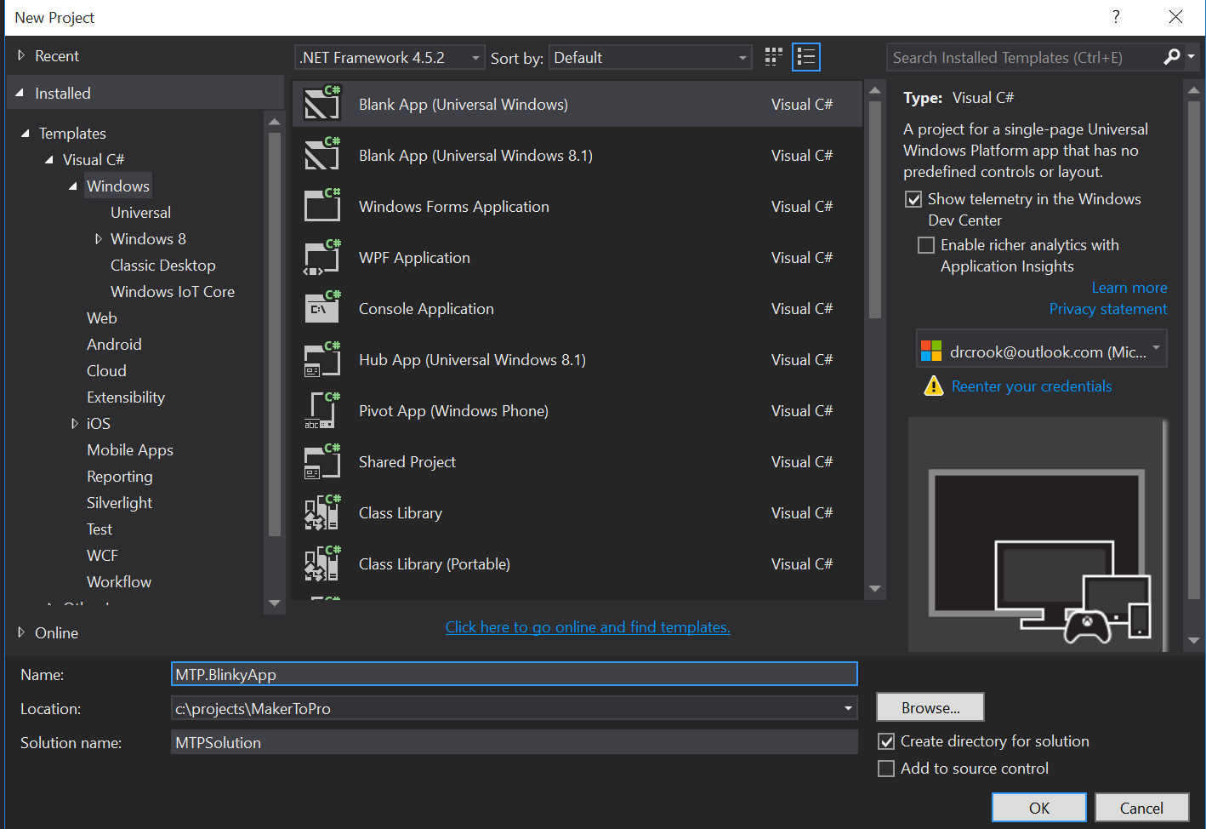

Slide 13
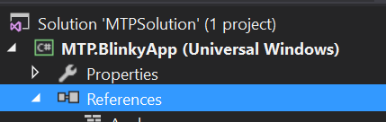
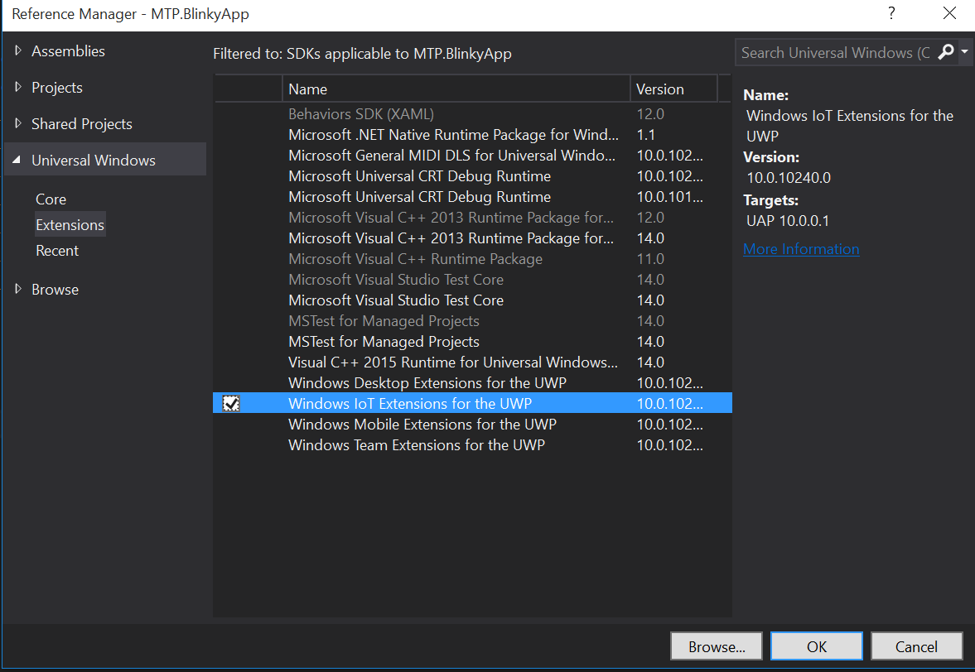
Getting Set Up
Add a Reference
Right Click -> Add Reference
Windows IoT Extensions for the UWP
Under Universal Windows
In Extensions
Select
Click Ok

Slide 14
Have these using statements
In the file App.Xaml.cs
using System;
using Windows.ApplicationModel;
using Windows.ApplicationModel.Activation;
using Windows.Devices.Gpio;
using Windows.UI.Xaml;
using Windows.UI.Xaml.Controls;
using Windows.UI.Xaml.Navigation;
Have these class level private variables
private const int ledPinNumber = 27;
private GpioPin ledPin;
private GpioPinValue ledVal;
private DispatcherTimer timer;

Slide 15
Modify the Constructor
public App()
{
Microsoft.ApplicationInsights.WindowsAppInitializer.InitializeAsync(
Microsoft.ApplicationInsights.WindowsCollectors.Metadata |
Microsoft.ApplicationInsights.WindowsCollectors.Session);
this.InitializeComponent();
this.Suspending += OnSuspending;
//Add these lines
InitGPIO();
InitBlinky();
}

Slide 16
Initialize GPIO
private void InitGPIO()
{
var gpio = GpioController.GetDefault();
if (gpio == null)
{
throw new Exception("Gpio expected on this device");
}
ledPin = gpio.OpenPin(ledPinNumber);
ledPin.SetDriveMode(GpioPinDriveMode.Output);
ledPin.Write(GpioPinValue.Low);
ledVal = GpioPinValue.Low;
}

Slide 17
Initialize Blinking
private void InitBlinky()
{
timer = new DispatcherTimer();
timer.Interval = TimeSpan.FromMilliseconds(500);
timer.Tick += Timer_Tick;
timer.Start();
}

Slide 18
Add Handler for Timer Tick
private void Timer_Tick(object sender, object e)
{
if(ledVal == GpioPinValue.High)
{
ledPin.Write(GpioPinValue.Low);
ledVal = GpioPinValue.Low;
}
else
{
ledPin.Write(GpioPinValue.High);
ledVal = GpioPinValue.High;
}
}

Slide 19
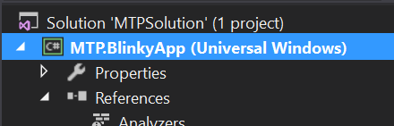
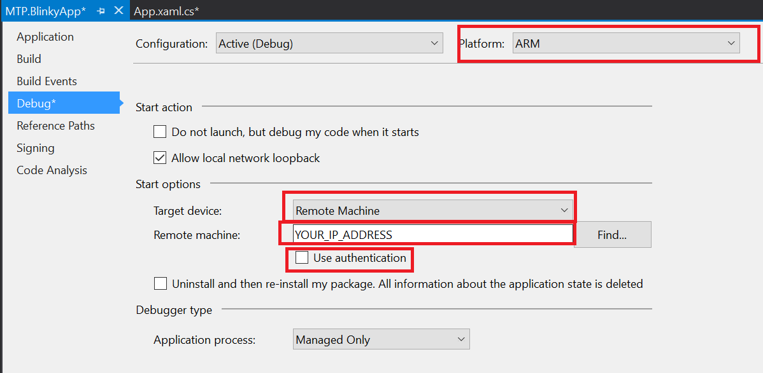
Set Build for your Device
Right Click Project
Properties (at the bottom)
ARM
Remote
Your IP
No Auth

Slide 20
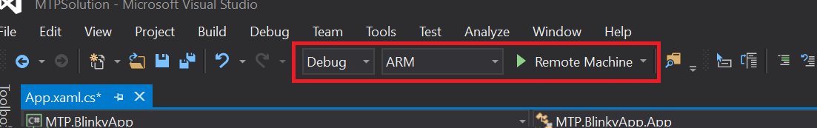
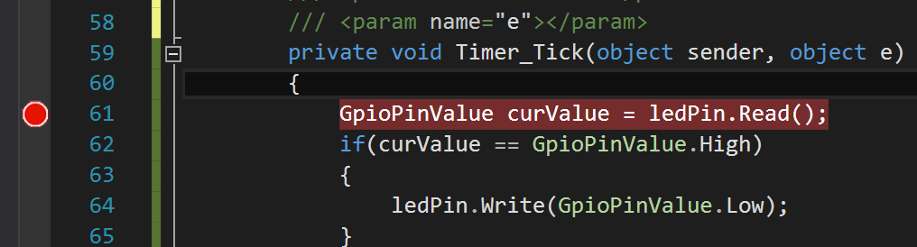
Deploy && Debug
Set to ARM
Click In Gray Area
Creates red breakpoint
Click Green Arrow
You can remove breakpoint and click green arrow to continue.

Slide 21
Take a breather

Slide 22
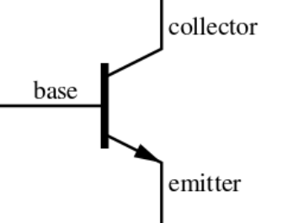
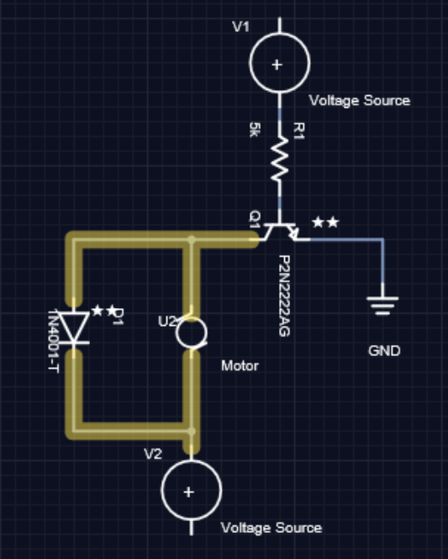
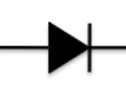
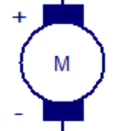
Circuit Schematics – Symbols – MOTORS!
Transistor
Diode
Motor

Slide 23
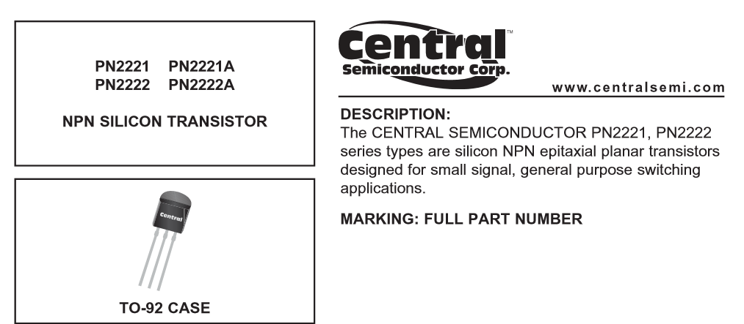
The Data Sheet – Part 1
We have: PN2222A

Slide 24
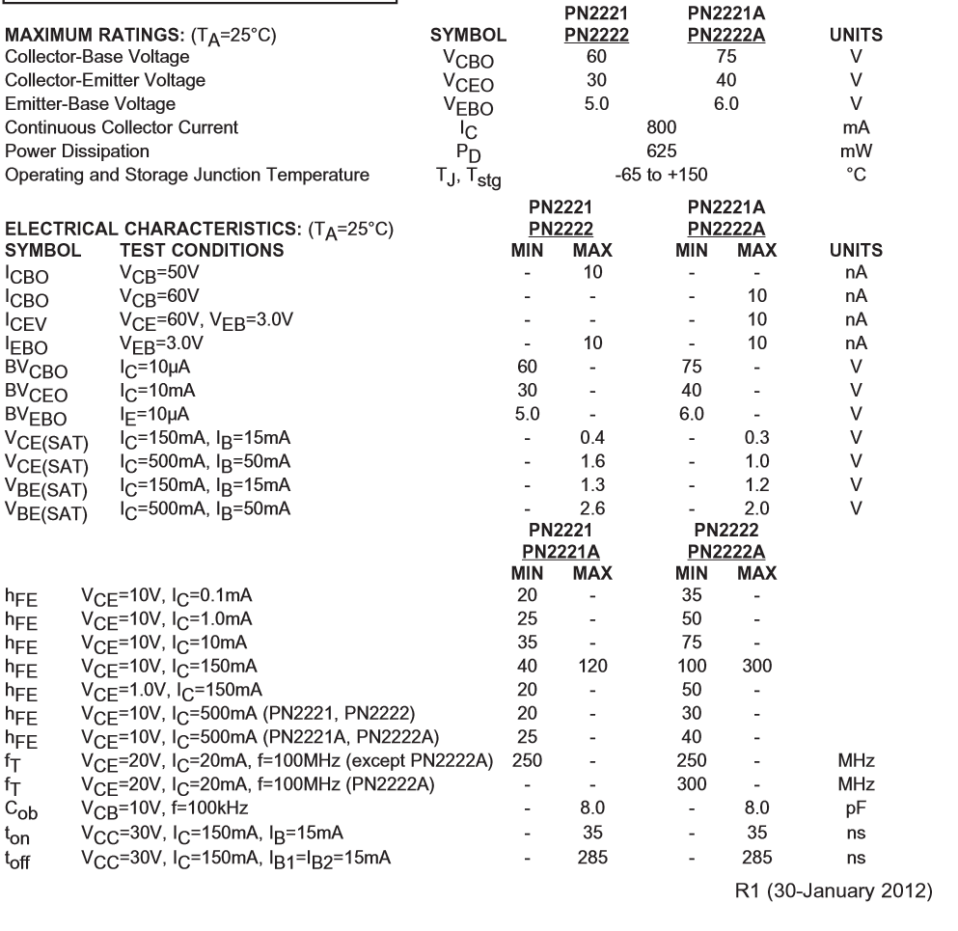
The Data Sheet – Part 2
Important here is
Maximum ratings

Slide 25
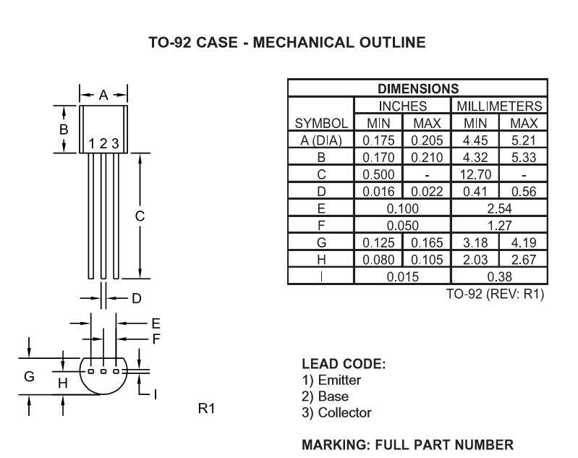
The Data Sheet – Part 3

Slide 26
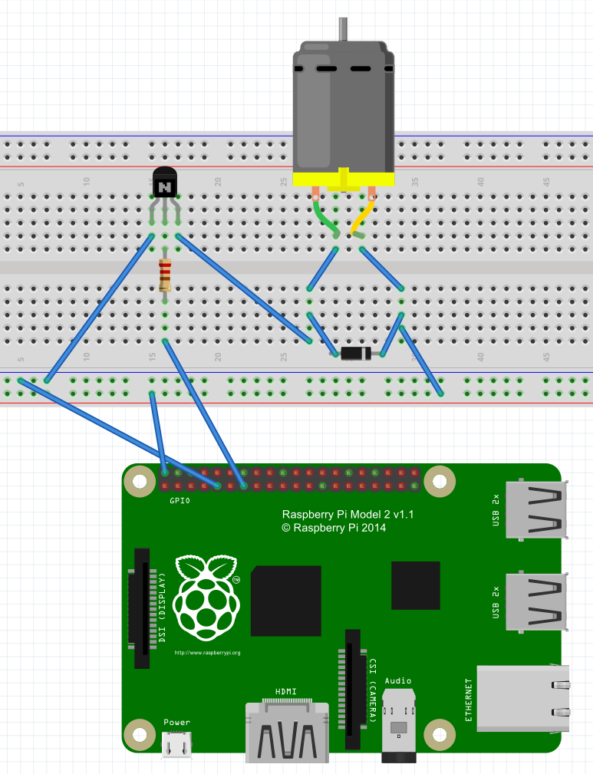
Wiring Diagram

Slide 27
The Code…
Remains EXACTLY the same ☺
We are switching the motor on/off every 500 milliseconds, just like we did with the LED.

Slide 28
What Next?

Slide 29
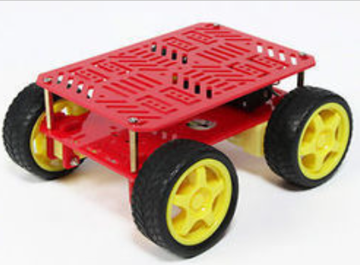
Create a car!
Control 4 motors
Create functions for:
Left
Right
Forward
Back

Slide 30

Control a Sprinkler System!

Slide 31
There is more!

Slide 32

Brown Bag Series
Electronics 101
3 Rotating Sessions
IoT 101
3 Rotating Sessions
Machine Learning 101
2 Rotating Sessions
3D Printing 101
Just 1 session!

Slide 33
Questions?

Slide 34
dacrook@Microsoft.com
(980)228-6278
@Data4Bots
www.indiedevspot.com

